Slide 1
Online technical challenge
Sudhakar Raju
11/07/2023

Slide 2

Agenda
Challenge 1 - 3 Tier Architecture in Azure Cloud
Challenge 2 - Query Meta Data in Azure
Challenge 3 - Get the value using coding

Slide 3
Introduction
For the technical discussion, these slides has prepared by me to share my understanding and my inputs with architectural diagram , coding and key points for requested challenges . I will be sharing the details with reason “why “& for “what” the tooling's /resources , etc are been used

Slide 4
Challenge # 1
A 3-tier environment is a common setup. Use a tool of your choosing/familiarity create these resources on a cloud environment (Azure/AWS/GCP). Please remember we will not be judged on the outcome but more focusing on the approach, style and reproducibility

Slide 5
3 Tier Architecture in Azure Cloud
Overview of Network Topology
Hub & Spoke Model
Subnet + Network Access
Deploying different stages ( DEV , QA , STG & PROD )
Other Azure Services

Slide 6
Why Hub & Spoke ?
Network Isolation
Separation of Concern
Governance and Compliance

Slide 7
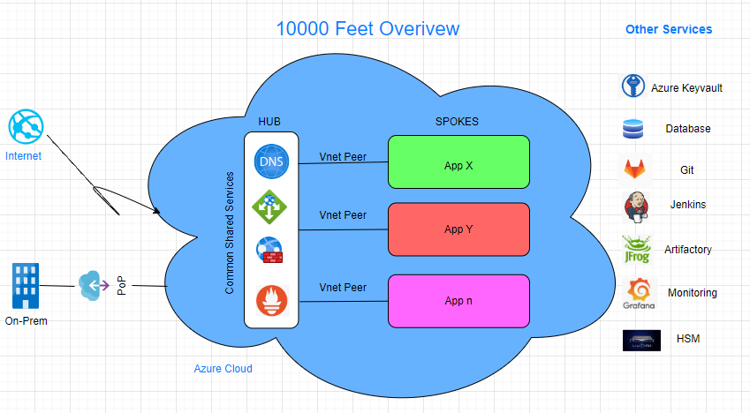

Slide 8
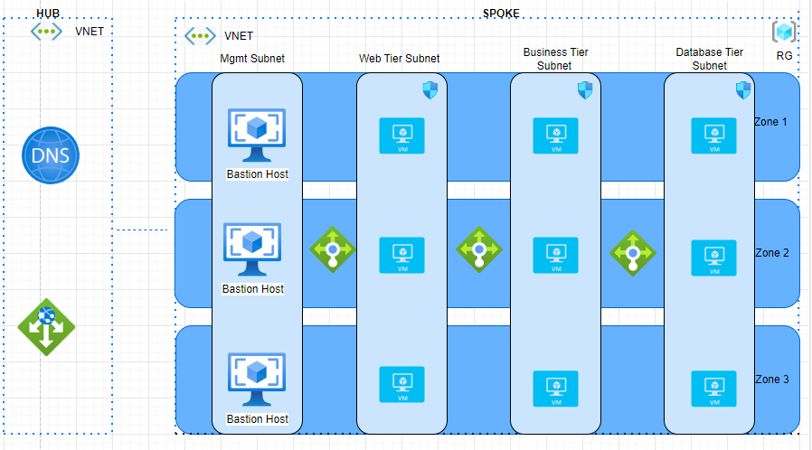

Slide 9




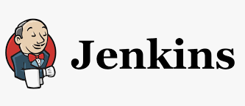

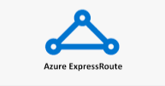



Azure Service and other supporting services/tooling's

Slide 10
Challenge # 2
We need to write code that will query the meta data of an instance within AWS or Azure or GCP and provide a Json formatted output. The choice of language and implementation is up to you.

Slide 11

Querying meta data using PowerShell
Used Azure PowerShell to query the azure VM instance meta data
Walkthrough the real time command execution
Azure Instance Metadata Service
Json format can be also retrieved from portal on resources
Commands
az vm show --name testvm --resource-group test_rg --query 'networkProfile.networkInterfaces[].id’
az vm show --name testvm --resource-group test_rg | ConvertTo-Json

Slide 12
Challenge # 3
We have a nested object. We would like a function where you pass in the object and a key and get back the value. The choice of language and implementation is up to you.
Example Inputs object = {“a”:{“b”:{“c”:”d”}}}
key = a/b/c
object = {“x”:{“y”:{“z”:”a”}}}
key = x/y/z value = a

Slide 13

Demo
- Used Java script to execute the command and I will walk you through the java function and will execute the command real time and explain it line by line
- Demo using online fiddle-meta to execute the function and check the results

Slide 14
Java Script
function getValueFromJson(obj, keys) {
var key = keys.split("/");
console.log("keyArr test", key);
var value = obj;
for (var i=0; i<key.length; i++) {
value = value[key[i]];
console.log("value", value);
}
return value;
}
var obj = {'x':{'y':{'z':'a'}}};
var res = getValueFromJson(obj, "x/y/z");
console.log("Result ", res);

Slide 15




Thank you
Sudhakar Raju

